Slide 1


Predicting and Exploring Income Disparities by Gender and Race Using Machine Learning Techniques on Census Data
Chisimdi Nzotta
u2220890
Supervisor: Dr. Yang Li

Slide 2
Introduction
Machine learning techniques have gained widespread adoption across diverse use cases, providing valuable insights and solutions to numerous societal and global challenges. In this study, machine learning was adopted to investigate and predict the income gap based on gender and race. Multiple Linear Regression, XGBoost, Decision Tree, Support Vector Machines (SVM), and Random Forest were employed to achieve this goal. These algorithms were built to explain income disparity, provide insight into the factors contributing to it and the extent of their impact. The algorithms were trained with the 2021 USA census containing relevant socioeconomic variables to make predictions and generate intended insights.

Slide 3
Study Objectives
Determine the extent of the gender pay gap by analysing and quantifying the difference in income between men and women.
Assess the impact of factors like education and marital status on income by examining their association with income disparities.
1
3
Investigate the influence of race on income by examining and comparing the income levels of individuals from asian, black, and white racial backgrounds.
Explore the capability of machine learning techniques to evaluate, predict and provide insights into social issues such as income disparities.
2
4

Slide 4

Dataset Description
The dataset is the USA 2021 census data downloaded from IPUMS (Integrated Public Use Microdata Series)
It has an initial 16 variables and 1,371,582 observations. Irrelevant variables and observations were filtered out leaving 10 variables and 863343 observations.
The variables include sex, age, marital status, race, occupation, educational attainment, occupation, field of degree, industry, hours worked and income (the dependent variable).
Three of these variables (income, age and hours worked) were of the numeric data type while the rest of them were categorical.

Slide 5
Data Preparation
The dataset was explored and the following techniques and approaches were used to manipulate and prepare the data to ensure high-quality data for the analysis.
|
|
Data Reduction
Normalisation
Variables that represented detailed versions of existing variables were removed. Observations falling outside the age range of the labor force (16 to 64) and instances where hours worked was less than 10 hours or greater than 40 hours were also excluded from the dataset. This process aimed to eliminate potential outliers and obtain a more focused and relevant population for the study.
The dependent variable was normalised using various normalisation techniques , including min-max, z-score, and others. However, among these techniques, log transformation produced the most normal distribution. It also yielded the best results when used for building the algorithms. Therefore, the log transformation was chosen as the normalisation approach for this study.

Slide 6
Data Preparation
Correlation
|
|
|
Standardisation
Binary Classification
The numerical independent variables, age and hours worked, were standardised using min-max normalisation. Both the standardised and unstandardised versions of these variables were tested, and they produced the same mode results.
The independent variable was divided into two classes: less than 40,000 which will be encoded as 0 and more than 40,000 which will be encoded as 1 for the classification algorithms. 40,000 was chosen because it is the mean of the dependent variable and created a balanced classification.
Correlation analysis was conducted using the "polycor" R library. The variables hours worked, degree field, marital status, education, age, and occupation had the highest correlations with the dependent variable, income.

Slide 7
Machine Learning Results
The models were trained with 80% of the dataset and tested and evaluated with the remaining 20%.
The Multiple Regression analysis found that females and black people were associated with lower income. Significant predictors of income included hours worked, occupation, industry, education, degree field, age, marital status, sex, and race. The model's adjusted R-squared value was 0.5692.
The Random Forest model was unable to process the entire dataset without encountering an error so a randomly undersampled 10% of the data was used for training and testing. This model achieved an accuracy of 0.8005, a recall of 0.8267, a precision of 0.7895, and an F1 score of 0.8076.

Slide 8
Machine Learning Algorithms
The Decision Tree model achieved an accuracy of 0.8122, a recall of 0.8045, a precision of 0.8298, and an F1 score of 0.8162. The model predicted that women have a lower income compared to men. It also predicted that individuals from a white racial background earned the highest income, followed by Asians, while individuals from a black racial background earned the lowest income.
The Support Vector Machines ( SVN) model was unable to process the entire dataset without encountering an error so a randomly undersampled 10% of the data was used for training and testing. The model had an accuracy of 0.8003, a recall of 0.8244, a precision of 0.7904, and an F1 score of 0.8070.
The XGBOOST model had an accuracy of 0.8162, a recall of 0.807, a precision of 0.837, and an F1 score of 0.822. It identified hours worked, occupation, age, education and industry as the most important variables in that order.

Slide 9
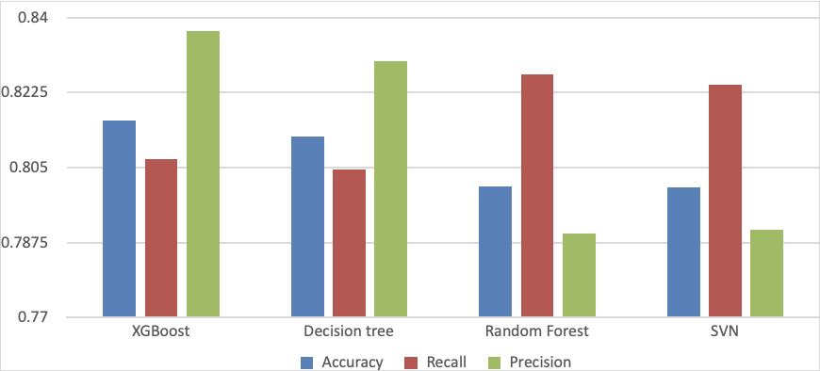
Comparison of Algorithm Performance
The XGBoost model demonstrated the best performance across all metrics, outperforming all the other models. Following XGBoost, the Decision Tree models performed well. The Random Forest model performed slightly better than SVN, which was the least performing model.

Slide 10
Conclusion
The analysis confirms the presence of income disparities, with women earning less than men. Individuals from white backgrounds earned the highest incomes, followed by Asians, while black individuals had the lowest earnings. On average, men had a mean income of $61,162.74, while women had a lower average income of $45,094.70. White individuals had the highest average income of $71,926.68, followed by Asians at $52,120.62, and black individuals at $41,197.83. Despite having the same predictor variables such as equal hours worked, education level, etc, an income gap was still identified.
The most influential factors affecting income were hours worked, occupation, education and age. Age and hours worked have a positive correlation with income. Individuals with higher levels of education earned more than those with lower levels and certain industries paid higher compared to others.
Future research should aim to extend beyond the scope and limitations of this study and delve deeper into the underlying causes of income disparities. It is also important to explore the complex interactions between predictor variables and their combined impact on income levels. Insight from such research can drive the development of effective strategies to address and mitigate these disparities.

Slide 11

Thank you! Questions please?

